Slide 1
What do you know about Sittingbourne?
Have a go at this quiz to see what you know, or could learn about Sittingbourne…
Just 10 Questions ….have a go!
Click here to continue

Slide 2
Ten Fascinating Questions about Sittingbourne
Where does the name ‘Sittingbourne’ originate from?
What did the Romans do for Sittingbourne?
Where and what are The Meads?
Where was Rose Hill house and who lived there?
Which Inn did Princess Victoria visit in Sittingbourne?
When did the Train Station arrive in Sittingbourne?
When did Brickmaking help put Sittingbourne on the map?
Who is our most famous Victoria Cross winner from WW1?
Which town is Sittingbourne twinned with?
Why does Sittingbourne have a Light Railway?
Click here to continue

Slide 3

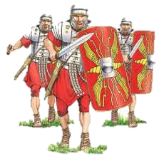
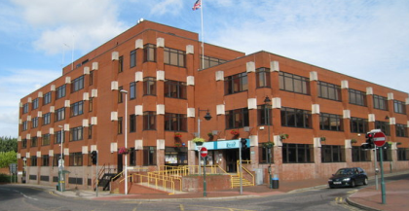
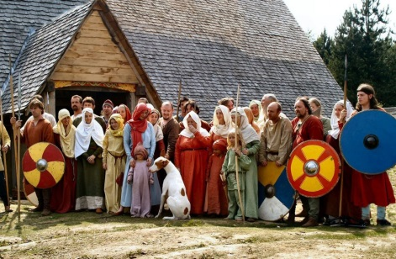
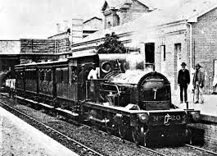
Q1. Where does the name ‘Sittingbourne’ originate from?
A
Swale Borough Council chose the name in 1947.
B
It dates from the Roman period.
C
D
The public chose its name in 1858 when the Victorians introduced the Railway line.
C
It dates from the Anglo- Saxon settlers.
D
Return to start
Click on A, B, C or D, as to which is the most likely answer

Slide 4



Q1. Where does the name ‘Sittingbourne’ originate from?
Well done!
It dates from the Anglo-Saxon settlers, is the correct answer…
The town of Sittingbourne was anciently written Sedingbourne, in Anglo-Saxon, Saedingburga, i.e. the hamlet by the bourne or small stream (which runs under Bell Road).
The Romans were in Sittingbourne, but Sittingbourne was just a small hamlet, and if it had a name before the Anglo-Saxons arrived, that has been lost.
C
It dates from the Anglo- Saxon settlers
Return to start
Click here to continue

Slide 5
Q1. Where does the name ‘Sittingbourne’ originate from?
C
Oops…the right answer is...
It dates from the Anglo-Saxon settlers, is the correct answer…
The town of Sittingbourne was anciently written Sedingbourne, in Anglo-Saxon, Saedingburga, i.e. the hamlet by the bourne or small stream (which runs under Bell Road).
The Romans were in Sittingbourne, but Sittingbourne was just a small hamlet, and if it had a name before the Anglo-Saxons arrived, that has been lost.
It dates from the Anglo- Saxon settlers
Return to start
Click here to continue

Slide 6
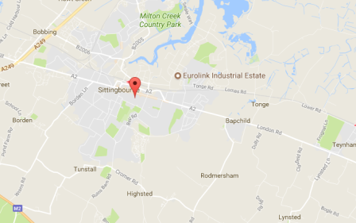
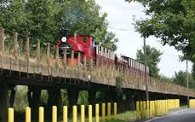
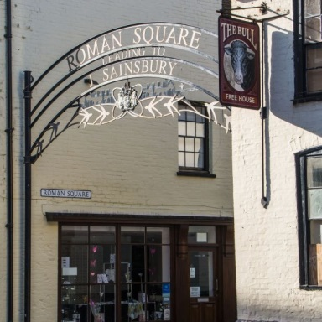
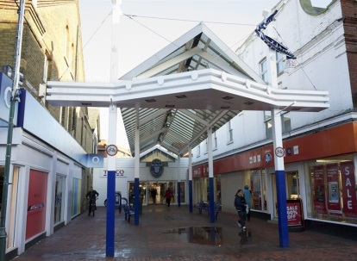
Q2. What did the Romans do for Sittingbourne?
A
Straight roads – The Main High Street is a Roman Road, and was part of the A2.
B
The Kemsley Light Railway is built on a Roman viaduct.
C
D
C
D
The Forum Shopping Centre was originally a Roman shopping precinct.
The Roman Square next to the Bull Pub was a Roman market.
Return to start
Click on A, B, C or D, as to which is the most likely answer

Slide 7
Q2. What did the Romans do for Sittingbourne?
A
Well done!
The Romans built the London to Dover Road known as ‘Watling Street’ (also known as the A2). The Main High Street of Sittingbourne is part of that route, and quite probably was a crossing point over the River Bourne, at Bell Road.
Straight roads – The Main High Street is a Roman Road, and was part of the A2.
Return to start
Click here to continue

Slide 8
Q2. What did the Romans do for Sittingbourne?
Oops…the right answer is...
The Romans built the London to Dover Road known as ‘Watling Street’ (also known as the A2). The Main High Street of Sittingbourne is part of that route, and quite probably was a crossing point over the River Bourne, at Bell Road.
A
Straight roads – The Main High Street is a Roman Road, and was part of the A2.
Return to start
Click here to continue

Slide 9
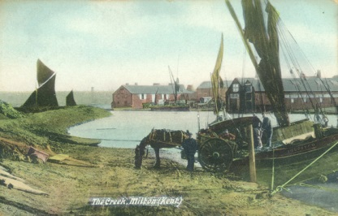
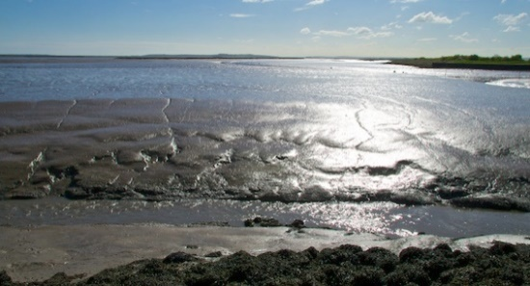
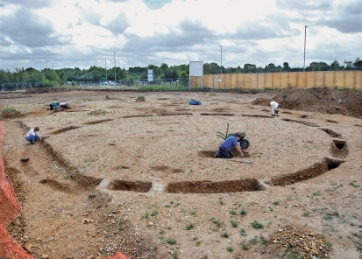
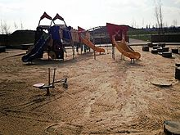
Q3. Where and what are The Meads?
A
B
On the edge of the Swale - the mud flats that are home to pre-historic footprints.
On the edge of the Milton Creek – a protected conservation area.
C
Near the Senora Fields development - prehistoric ring ditches and an Anglo-Saxon cemetery.
D
C
D
On the border with Bobbing – a new children’s play area, with a historic theme.
Return to start
Click on A, B, C or D, as to which is the most likely answer

Slide 10
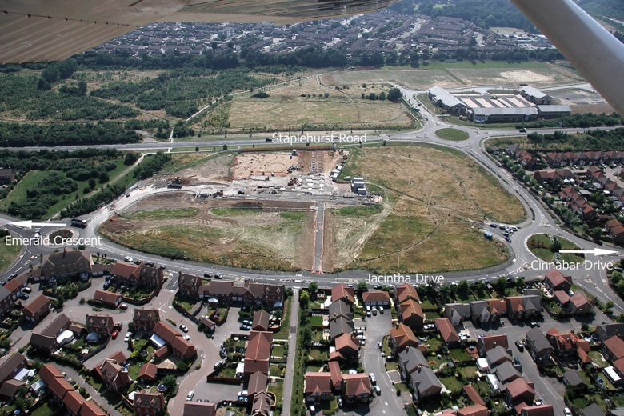
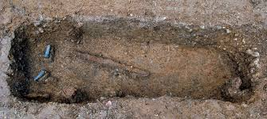
Q3. Where and what are The Meads?
C
Near the Senora Fields development - prehistoric ring ditches and an Anglo-Saxon cemetery.
Well done!
The 2008 excavations revealed evidence for Neolithic, Bronze Age and Anglo-Saxon activity, including a group of Beaker period burials, a Bronze Age ring-ditch (almost certainly the remains of a round barrow) and an extensive Anglo-Saxon cemetery.
Return to start
Click here to continue

Slide 11
Q3. Where and what are The Meads?
C
Near the Senora Fields development - prehistoric ring ditches and an Anglo-Saxon cemetery.
Oops…the right answer is...
The 2008 excavations revealed evidence for Neolithic, Bronze Age and Anglo-Saxon activity, including a group of Beaker period burials, a Bronze Age ring-ditch (almost certainly the remains of a round barrow) and an extensive Anglo-Saxon cemetery.
.
Return to start
Click here to continue

Slide 12
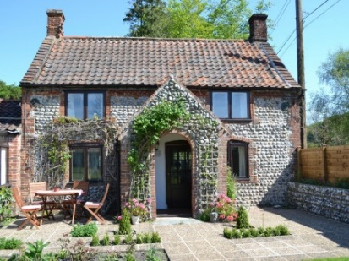
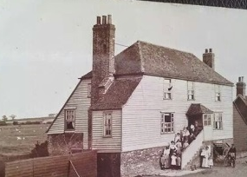
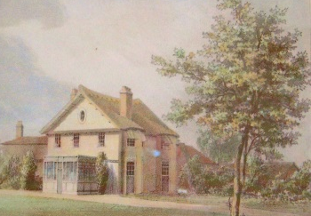
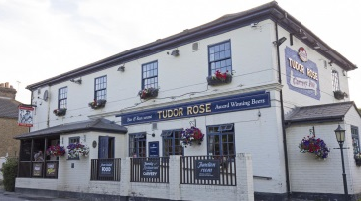
Q4. Where was Rose Hill House and who lived there?
A
The name of the home on the edge of the Milton Creek, where Dam Buster hero Johnny Johnson was born.
B
A cottage in Tunstall where Pam Ayers retired to.
C
Was the original name of the Tudor Rose in Chestnut Street, where Henry Tudor’s mistress lived.
D
Rose Hill House was a Georgian Home of Francis Montresor,
on the edge of Sittingbourne, near Bobbing.
C
D
Return to start
Click on A, B, C or D, as to which is the most likely answer

Slide 13
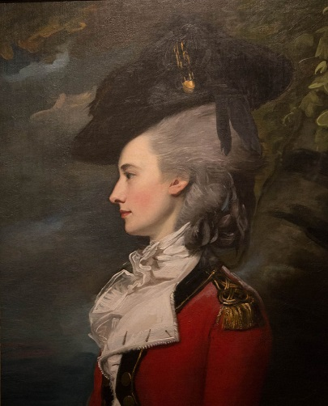
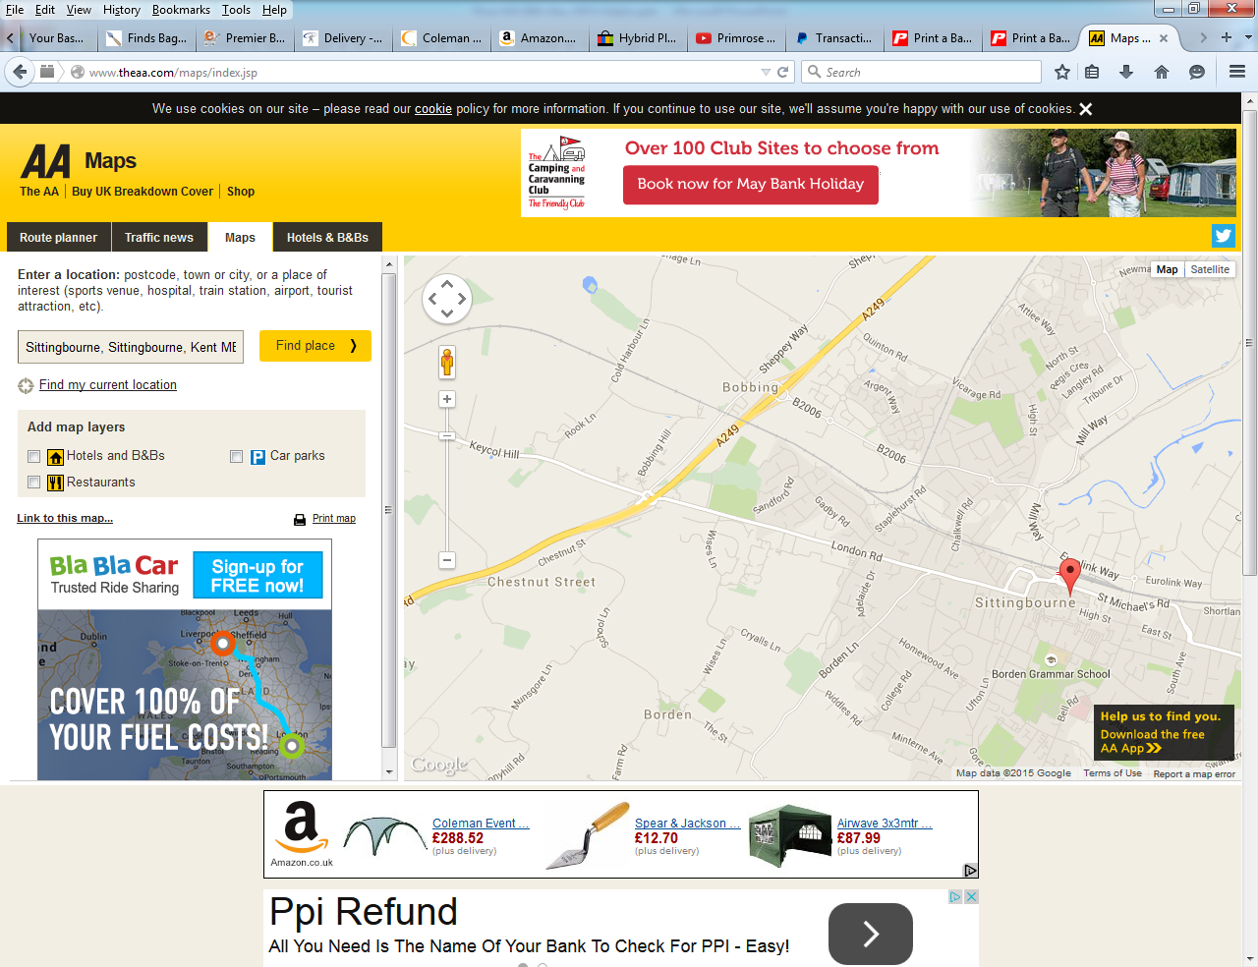
Q4. Where was Rose Hill House and who lived there?
Rose Hill House was a Georgian Home of Francis Montresor,
on the edge of Sittingbourne, near Bobbing
Well done!
Frances Montresor, born in 1744 was married in 1764 to John Montresor, George III’s Chief Engineer for the Americas.
D
This painting of Frances in 1778 hangs in the Harry S. Truman building of the US Department of State in Washington.
She lived at Rose Hill from around 1800, after her husband died in Maidstone Goal!
Return to start
Click here to continue

Slide 14
Q4. Where was Rose Hill House and who lived there?
D
Rose Hill House was a Georgian Home of Francis Montresor,
on the edge of Sittingbourne, near Bobbing
Oops…the right answer is...
Frances Montresor, born in 1744 was married in 1764 to John Montresor,
George III’s Chief Engineer for the Americas. This painting of Frances in 1778 hangs in the Harry S. Truman building of the US Department of State in Washington.
She lived at Rose Hill from around 1800, after her husband died in Maidstone Goal!
Return to start
Click here to continue

Slide 15
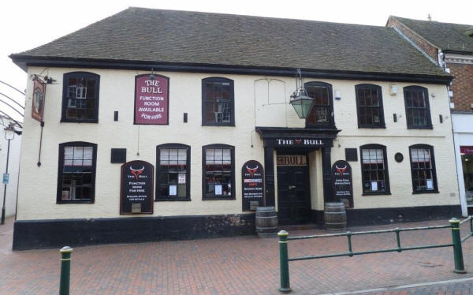
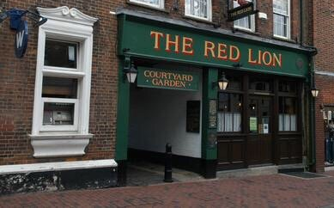
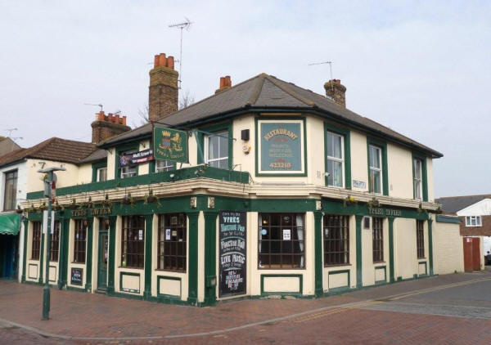
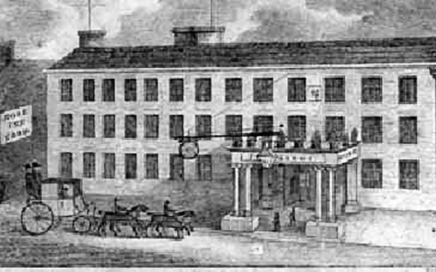
Q5. Which Inn did Princess Victoria visit in Sittingbourne?
A
B
The Red Lion
The Bull
C
D
C
D
The Rose Inn
Ypres Tavern
Return to start
Click on A, B, C or D, as to which is the most likely answer

Slide 16
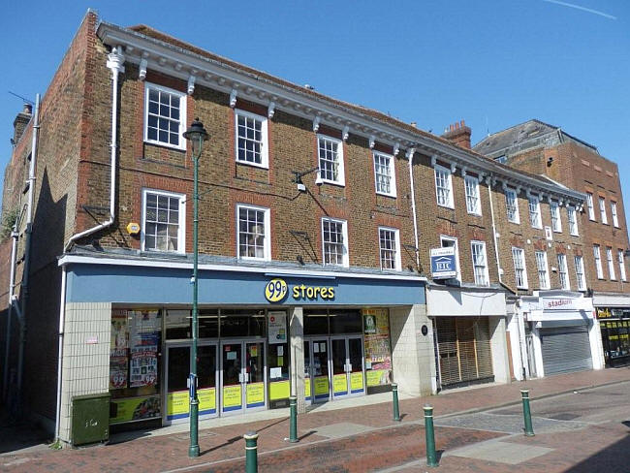
Q5. Which Inn did Princess Victoria visit in Sittingbourne?
C
Well done!
The Rose Inn, is the correct answer…
It is no longer an Inn, but is 4 retail units in the High Street.
In 1825 Princess (later Queen) Victoria stayed here overnight. Imagine the excitement this caused! The Rose, where she stayed, was at the time described as ‘perhaps the most superb [Inn] of any throughout the kingdom’.
The Rose Inn
Return to start
Click here to continue

Slide 17

Q5. Which Inn did Princess Victoria visit in Sittingbourne?
C
Oops…the right answer is...
The Rose Inn, is the correct answer…
It is no longer an Inn, but is 4 retail units in the High Street.
In 1825 Princess (later Queen) Victoria stayed here overnight. Imagine the excitement this caused! The Rose, where she stayed, was at the time described as ‘perhaps the most superb [Inn] of any throughout the kingdom’.
The Rose Inn
Return to start
Click here to continue

Slide 18
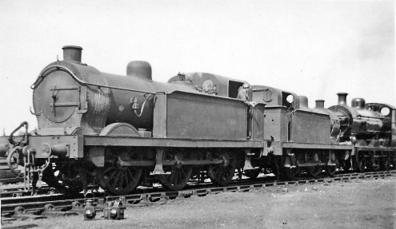
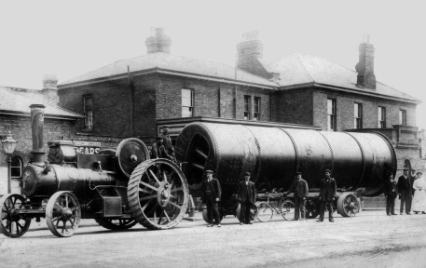
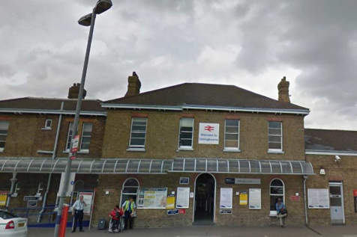
Q6. When did the Train Station arrive in Sittingbourne?
A
The initial act of parliament in 1825 enabled the Canterbury to London line to open.
B
In 1858, Sittingbourne’s first train service ran between Faversham and Chatham.
C
D
Recently – opened in 1939 due to the Second World War effort.
C
The Edwardian’s opened it in 1910 – look at those bricks.
D
Return to start
Click on A, B, C or D, as to which is the most likely answer

Slide 19
Q6. When did the Train Station arrive in Sittingbourne?
Well done!
1858, is the correct answer…
On 25th January 1858, Sittingbourne was placed on the railway map when the East Kent Railway initiated its first train service on newly-laid lines between Faversham and Chatham. Its connection to the capital was not quite complete as a horse and cart service operated between Chatham and Strood stations. On 19th July 1860, the station's importance increased when it became the interchange point for branch services to Queenborough and Sheerness.
B
In 1858, Sittingbourne’s first train service ran between Faversham and Chatham.
Return to start
Click here to continue

Slide 20
Q6. When did the Train Station arrive in Sittingbourne?
Oops…the right answer is....
On 25th January 1858, Sittingbourne was placed on the railway map when the East Kent Railway initiated its first train service on newly-laid lines between Faversham and Chatham. Its connection to the capital was not quite complete as a horse and cart service operated between Chatham and Strood stations. On 19th July 1860, the station's importance increased when it became the interchange point for branch services to Queenborough and Sheerness.
B
In 1858, Sittingbourne’s first train service ran between Faversham and Chatham.
Return to start
Click here to continue

Slide 21
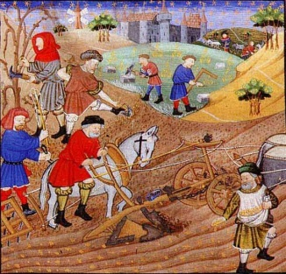
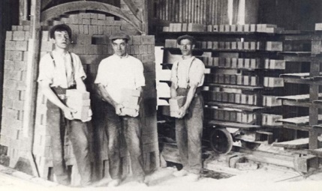
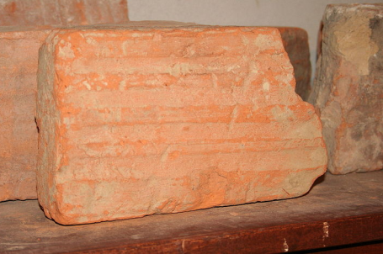
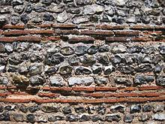
Q7. When did Brickmaking help put Sittingbourne on the map?
A
B
Kent brown earth is suitable for making bricks, which they did in 14th and 15th centuries (1301-1500).
The Kent yellow stock made its name in the 19th Century.
C
The early medieval 500 – 1000 AD period saw the start of brickmaking.
D
C
D
The Romans made thousands of Bricks to build the town.
Return to start
Click on A, B, C or D, as to which is the most likely answer

Slide 22
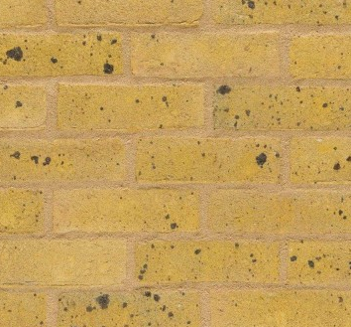
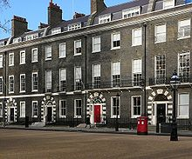
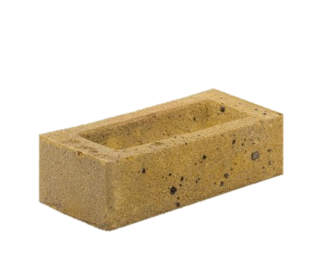
Q7. When did Brickmaking help put Sittingbourne on the map?
A
Well done!
Stock brick making started in Kent around 1700, but it was the Kent yellow stock (known as London stocks) which made its name in the 19th Century. Murston became the brick making centre of the area, adding to Sittingbourne’s overall growth.
As London grew, Sittingbourne, with it’s barges and Milton Creek were ideally placed to supply London with bricks.
The Kent yellow stock made its name in the 19th Century.
Return to start
Click here to continue

Slide 23
Q7. When did Brickmaking help put Sittingbourne on the map?
A
Oops…the right answer is...
Stock brick making started in Kent around 1700, but it was the Kent yellow stock (known as London stocks) which made its name in the 19th Century. Murston became the brick making centre of the area, adding to Sittingbourne’s overall growth.
As London grew, Sittingbourne, with it’s barges and Milton Creek were ideally placed to supply London with bricks.
The Kent yellow stock made its name in the 19th Century.
Return to start
Click here to continue

Slide 24
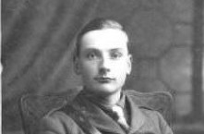
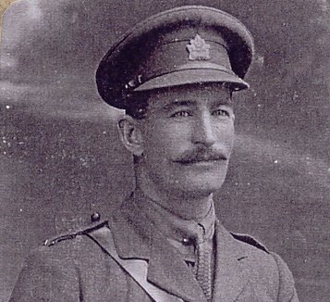
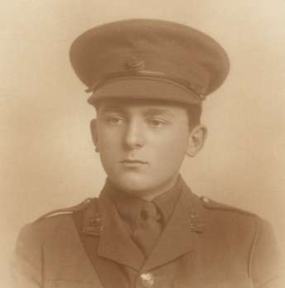
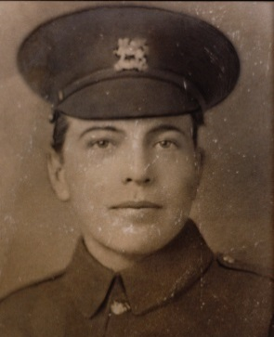
Q8. Who is our most famous Victoria Cross winner from WW1?
A
B
Charles Apps
Donald Dean
C
D
C
D
Alan Bowles
Frank Young
Return to start
Click on A, B, C or D, as to which is the most likely answer

Slide 25
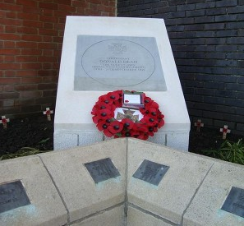
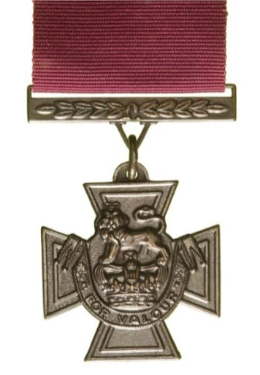
Q8. Who is our most famous Victoria Cross winner from WW1?
A
Well done!
Donald John Dean was 21 when he was awarded the Victoria Cross for deeds carried out in France in 1918, when he was a temporary Lieutenant in the 8th Battalion of the Queen’s Own Royal West Kent Regiment. Donald also served in the 2nd World War, as a Colonel, and received an OBE.
There is a stone at Central Avenue, near the main war memorial, that commemorates his winning the VC.
Donald Dean
The Rose Inn
Return to start
Click here to continue

Slide 26
Q8. Who is our most famous Victoria Cross winner from WW1?
Oops…the right answer is...
Apps, Bowles and Young, were brave man in their own right, and did serve as local men in the first World War, but Donald John Dean was 21 when he was awarded the Victoria Cross for deeds carried out in France in 1918, when he was a temporary Lieutenant in the 8th Battalion of the Queen’s Own Royal West Kent Regiment. Donald also served in the 2nd World War, as a Colonel, and received an OBE.
There is a stone at Central Avenue, near the main war memorial, that commemorates his winning the VC.
A
Donald Dean
Return to start
Click here to continue

Slide 27




Q9. Which town is Sittingbourne twinned with?
A
A town also called Sittingbourne in The United States of America.
B
Ypres in Belgium.
C
D
C
D
Brussels, the centre of the European Union.
Saedingburga in Germany.
Return to start
Click on A, B, C or D, as to which is the most likely answer

Slide 28
Q9. Which town is Sittingbourne twinned with?
Well done!
Ypres, is the correct answer…
In around 1964 Sittingbourne became the only town to be twinned with Ypres.
The idea behind twinning with another town in Europe was to find towns that suffered during the wars and pair them together. The aim was to help bring together the communities, and encourage people from these areas to meet, mix and get along.
B
Ypres in Belgium
Return to start
Click here to continue

Slide 29
Q9. Which town is Sittingbourne twinned with?
Oops…the right answer is....
Ypres, is the correct answer…
In around 1964 Sittingbourne became the only town to be twinned with Ypres.
The idea behind twinning with another town in Europe was to find towns that suffered during the wars and pair them together. The aim was to help bring together the communities, and encourage people from these areas to meet, mix and get along.
B
Ypres in Belgium
Return to start
Click here to continue

Slide 30
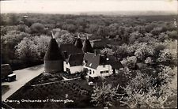
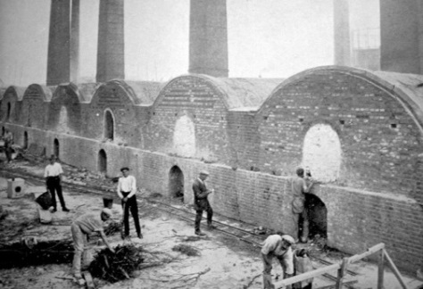
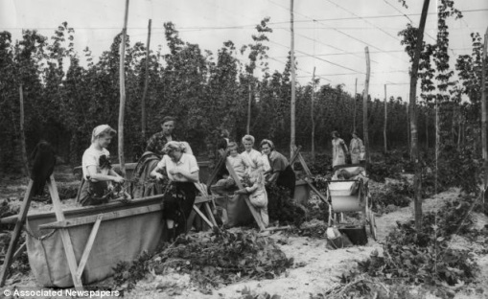
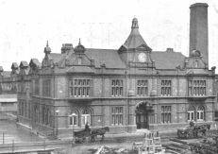
Q10. Why does Sittingbourne have a Light Railway?
A
B
The Brick industry needed a way to transport bricks up to London.
To move all the fruit grown locally to the London markets.
C
Transport the hops over to the Faversham Neame brewery.
D
The Paper Mill needed a way to transport goods across its site.
C
D
Return to start
Click on A, B, C or D, as to which is the most likely answer

Slide 31
Q10. Why does Sittingbourne have a Light Railway?
The Paper Mill needed a way to transport goods across its site.
Well done!
The Sittingbourne & Kemsley Light Railway (SKLR) line is a two mile long site, built in 1905 for the manufacture of paper at Edward Lloyd Paper Mill; once the biggest in the world. The line which is built to a gauge of 2′ 6″, continues to use the steam engines and rolling stock that were supplied to operate the railway in its working life prior to preservation in 1969. The railway was originally horse drawn and was centred around the wharf on Milton Creek.
D
SKLR is open April to September and also in December. Checkout their website for specific dates and times. www.sklr.net
Return to start
Click here to continue

Slide 32
Q10. Why does Sittingbourne have a Light Railway?
D
The Paper Mill needed a way to transport goods across its site.
Oops…the right answer is...
The Sittingbourne & Kemsley Light Railway (SKLR) line is a two mile long site, built in 1905 for the manufacture of paper at Edward Lloyd Paper Mill; once the biggest in the world. The line which is built to a gauge of 2′ 6″, continues to use the steam engines and rolling stock that were supplied to operate the railway in its working life prior to preservation in 1969. The railway was originally horse drawn and was centred around the wharf on Milton Creek.
SKLR is open April to September and also in December. Checkout their website for specific dates and times. www.sklr.net
Finish
Click here to continue

Slide 33

Well done – you have completed the quiz!
Hope you learnt a little more about Sittingbourne…
Have a look round and see what else you could learn!
Return to start
Return to start

